Slide 1
Photonic slot routing

Slide 2
Photonic slot routing
PSR
  Wavelength-routing AONs interconnect pairs of source & destination nodes via all-optical point-to-point lightpaths
  Due to cost & efficiency reasons, it is impossible to interconnect each pair of nodes by a dedicated lightpath
  Possible solutions
    Use of multiple lightpaths => loss of transparency
    Electronic traffic grooming at each source node
  Alternative solution: Photonic slot routing (PSR)
    Avoids loss of transparency & need for electronic traffic grooming
    Intermediate nodes switch entire slots, each carrying multiple packets on distinct wavelength channels, all-optically & individually without OEO conversion
    Allows traffic aggregation to be done optically without electronic traffic grooming

Slide 3
Photonic slot routing
Photonic slot
  In PSR networks, time is divided into fixed-size slots
  Each slot spans all W wavelengths with both slot boundaries aligned across all wavelengths => photonic slot
  Photonic slot
    May contain a single data packet on each wavelength
    All packets in a given photonic slot are required to be destined for the same node
    Each photonic slot may be destined for a different node
    Routed as a single entity
  Advantages
    No wavelength-sensitive components needed at intermediate nodes => lower costs & avoidance of interchannel switching crosstalk
    Reduced complexity of switching operation & electronic control by factor W (number of wavelengths)
    Cost-effective realization by using simple optical components

Slide 4
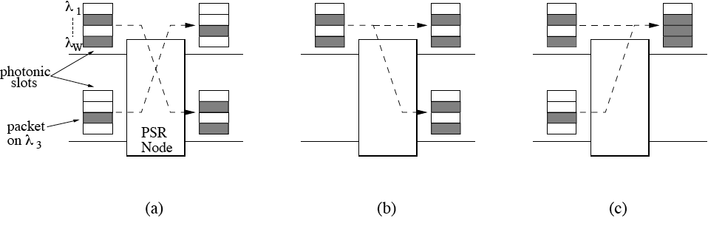
Photonic slot routing
PSR functions
  (a) photonic slot switching
    Contention resolution
  (b) photonic slot copying
    Multicasting
  (c) photonic slot merging

Slide 5
Photonic slot routing
Synchronization
  To achieve PSR functions, photonic slots must arrive synchronized at PSR nodes
  Synchronization approaches
    Optical synchronizer (local)
      Use of fiber delay lines (FDLs) at input ports of PSR nodes to delay arriving photonic slots
    Network-wide photonic slot synchronization
      Example: Two-layer PSR network
        Central unidirectional ring interconnecting multiple folded bus networks
        Step 1: Photonic slot synchronization on ring through nominated master ring node using ping technique
        Step 2: Photonic slot synchronization on folded buses by copying pings on ring onto each attached bus

Slide 6
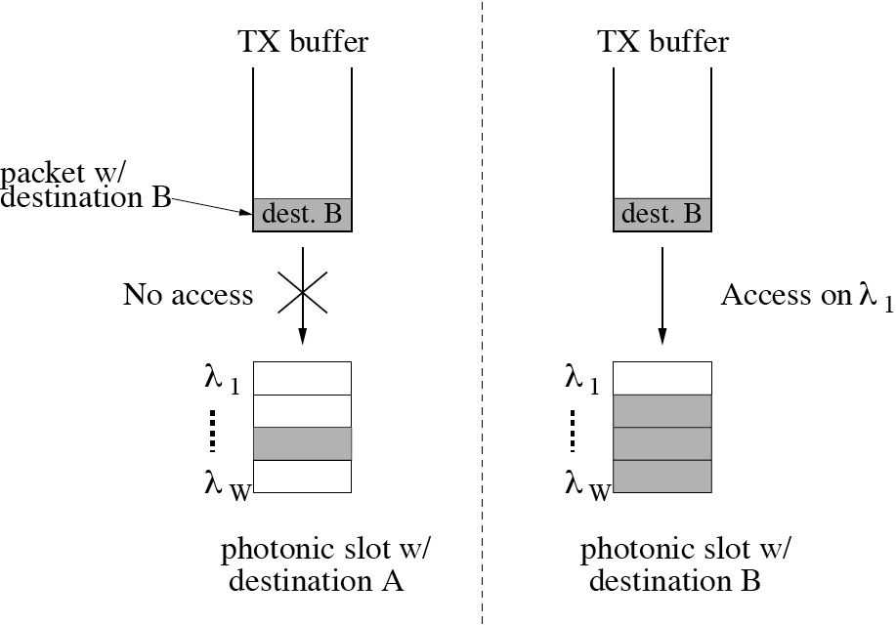
Photonic slot routing
Access control
  Each photonic slot has its own destination address (unicast, multicast, or network segment, e.g., above folded bus)
  Access control
    Source node is allowed to send packet on any free wavelength of arriving photonic slot if its destination address matches the packet’s destination address

Slide 7
Photonic slot routing
Sorting access protocol
  Used by each source node to ensure collision-free wave-length channel access & organize packet transmission
  Operation
    Destination address of first packet transmitted in a given photonic slot determines its destination address
    Each source node stores packets in separate transmission buffers according to their destination address
    Packet selection at source node
      If arriving photonic slot is assigned a destination
        Head-of-line packet of buffer associated with destination is selected for transmission, provided not all wavelengths are used
      If arriving photonic slot is not assigned a destination
        Oldest packet among head-of-line packets is selected for transmission

Slide 8
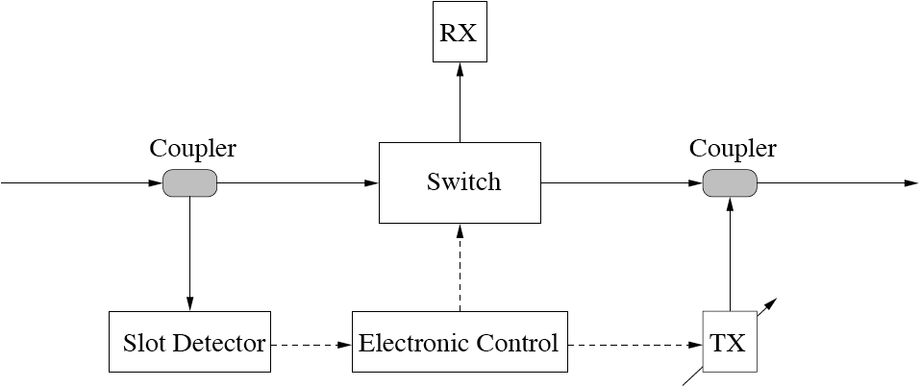
Photonic slot routing
PSR node
  Coupler taps part of incoming signal off input fiber link
  Slot detector finds out
    Whether arriving photonic slot is destined for local node
    Which wavelengths in arriving photonic slot carry packets
  Based on this information
    Switch is set by electronic control
    Locally generated packet is inserted using another coupler

Slide 9
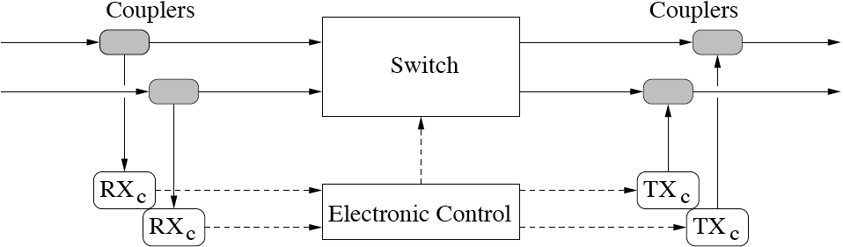
Photonic slot routing
PSR bridge
  Interconnects different PSR network segments
  Example: 2x2 PSR bridge
    Equipped with photonic 2x2 cross-bar switch
    Two pairs of control receiver RX_{C} and control transmitter TX_{C}
    RX_{C} inform bridge control unit of destination of photonic slots arriving on each network segment
    Electronic control sets switch in bar or cross state

Slide 10
Photonic slot routing
PSR bridge: Contention
  In PSR networks, photonic slots may experience contention at intermediate PSR bridges
  Contention
    Occurs when more than one photonic slot simultaneously arriving at a given PSR bridge need to be switched to the same output port
  Possible solutions
    Only one photonic slot is switched while remaining ones are dropped by PSR bridge & retransmitted by source PSR nodes
    Alternatively, PSR bridge resolves contention

Slide 11
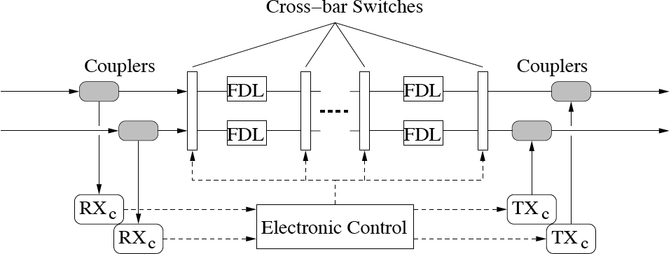
Photonic slot routing
SDL bridge
  Contention can be completely avoided by assigning connection requests to periodically recurring collision-free TDM frames
  Contention can be mitigated by adding switched delay line (SDL) to PSR bridge => SDL bridge
    Combination of concatenated i FDLs & i+1 photonic cross-bar switches controlled on a photonic slot basis, where i ≥ 0

Slide 12
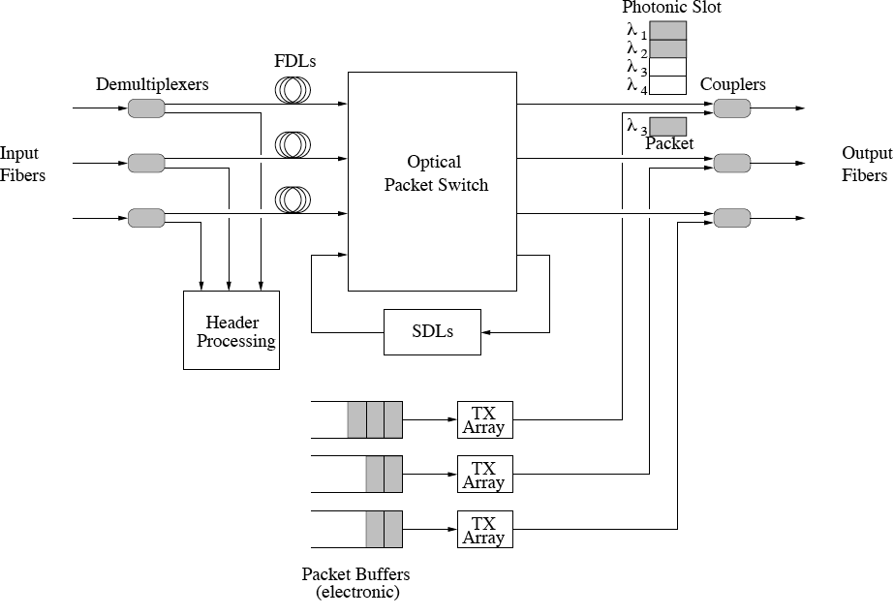
Photonic slot routing
Multiport SDL bridge/PSR node

Slide 13
Photonic slot routing
Contention resolution
  Schemes to resolve contention in mesh PSR networks
    Retransmission of dropped photonic slots by source PSR nodes
    Buffering contending photonic slots at SDL bridges
    Deflection routing
      One photonic slot is routed through output fiber link specified by routing algorithm whereas other contending slots are routed through any of remaining free output fiber links
      Deflection counter in photonic slots prevents slots from being deflected too often
      Benefits heavily depend on topology & routing algorithm
  Results for shortest path routing
    Under low load: Buffering & deflection routing achieve similar throughput-delay performance
    With increasing load: Deflection routing may outperform buffering by means of load balancing

Slide 14
Photonic slot routing
Pros & cons of PSR
  PSR networks have pros & cons
    Pros
      Can be realized using inexpensive wavelength-insensitive devices & cross-connects based on proven technologies
    Cons
      PSR nodes ready to send packets to destinations other than that of photonic slot are prevented from using it, even though most wavelengths may be free
  This inefficiency can be avoided by neglecting the require-ment that all wavelengths need to be destined for same node
  As a consequence, each individual wavelength can be accessed independently from each other => individual wavelength switching (IWS)

Slide 15
Photonic slot routing
IWS
  Cost of optical components & switches expected to decrease significantly in the long run
  With optical technology advances, cost-effective wavelength-sensitive optical packet switches become feasible (e.g., WSXC)
  Resultant wavelength-sensitive IWS switch able to switch optical fixed-size packets on each individual wavelength
  Results
    Network capacity can be increased significantly by carefully replacing a relatively small percentage of conventional PSR switches with IWS switches according to given traffic demands and/or cost constraints
    Thus, IWS enables cautious upgrade & smooth migration paths from PSR networks to synchronous fixed-size optical packet switching (OPS) networks

Slide 16
Photonic slot routing
Implementation
  To date, PSR networks were experimentally investigated only to a limited extent
    Wavelength stacking
      Enables PSR nodes to send/receive multiple packets in each photonic slot using only one tunable transceiver

Slide 17
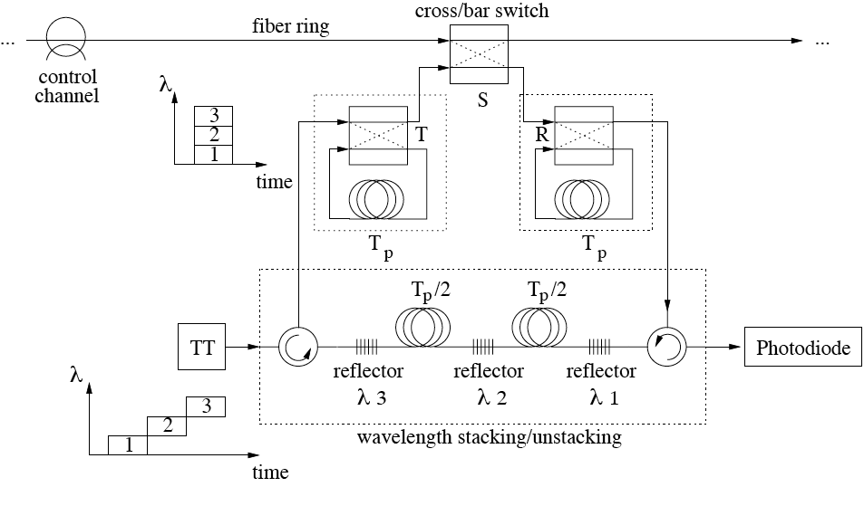
Photonic slot routing
Wavelength stacking

